Slide 1





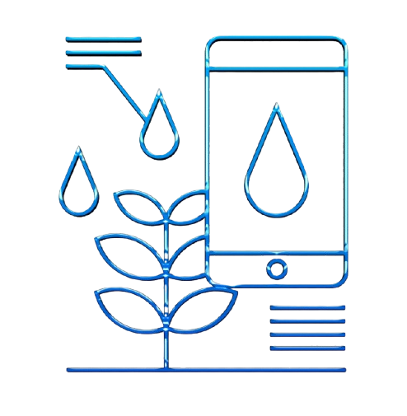
SmartFarmIA.TN
AI Impact Challenge
Eya El Kamel
Hadil Fares
2024/09/06

Slide 2


Table of Contents
Introduction
Solution
01
02
Problem Statement
03
Methodology&Implementation
Result
Conclusion
04
05
06

Slide 3

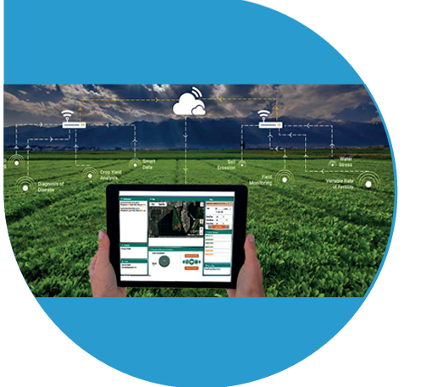
Introduction

Slide 4


Introduction
The scarcity of water, exacerbated by increasing demand and the impacts of climate change, has pushed those in charge of water management in Tunisia to reconsider their intervention strategies. Despite having significant assets in water management that have enabled the country to navigate challenging situations and numerous constraints like climate issues, there are still pressing challenges.

Slide 5
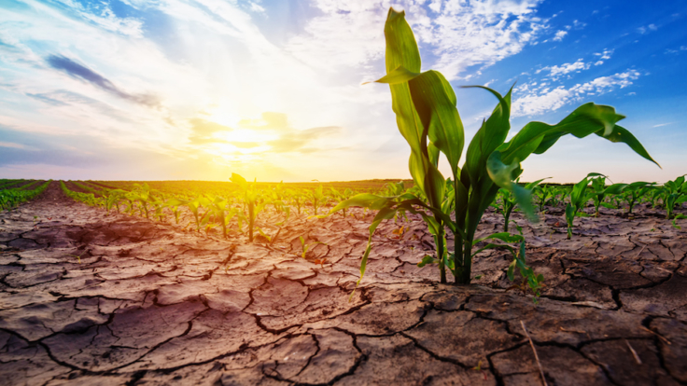
Problem Statement
06

Slide 6

Problem Statement
The situation of the water field is characterized by the fact that the rationalization and regulation devices do not work at the optimum. This results in losses of efficiency at all levels, which are very difficult to reconcile with a water context marked by both scarcity and irregularity, which will become much worse with today's reality and the prospect of climate change.
Also, if there is no qualitative change in the way of thinking and conducting public water policy, serious consequences will affect the viability of the entire system, with ecological, social and economic effects.

Slide 7
03
Solution

Slide 8




Solution
IOT Based Smart Agriculture
AI and Machine Learning Models
Mobile Access

Slide 9


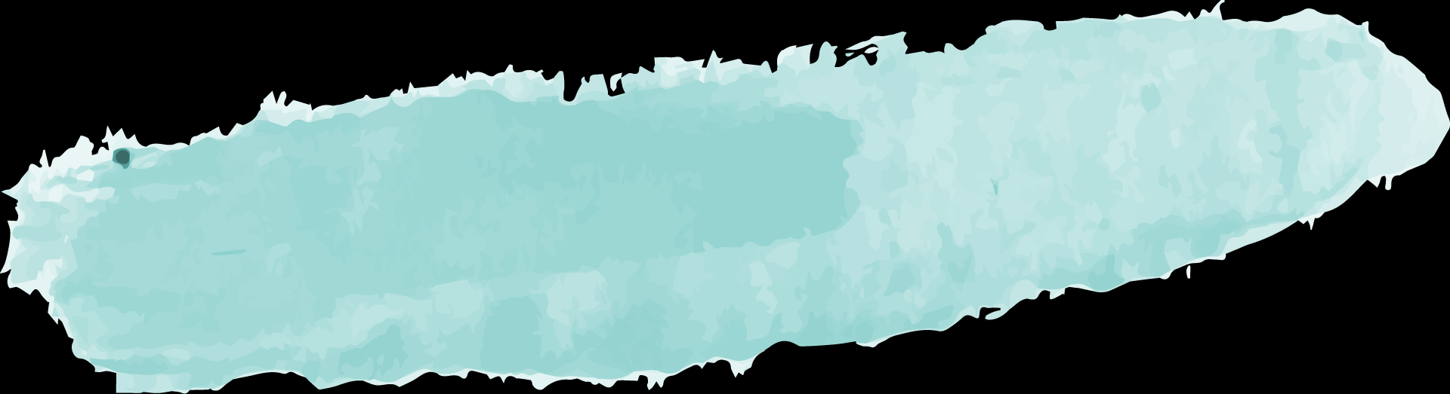
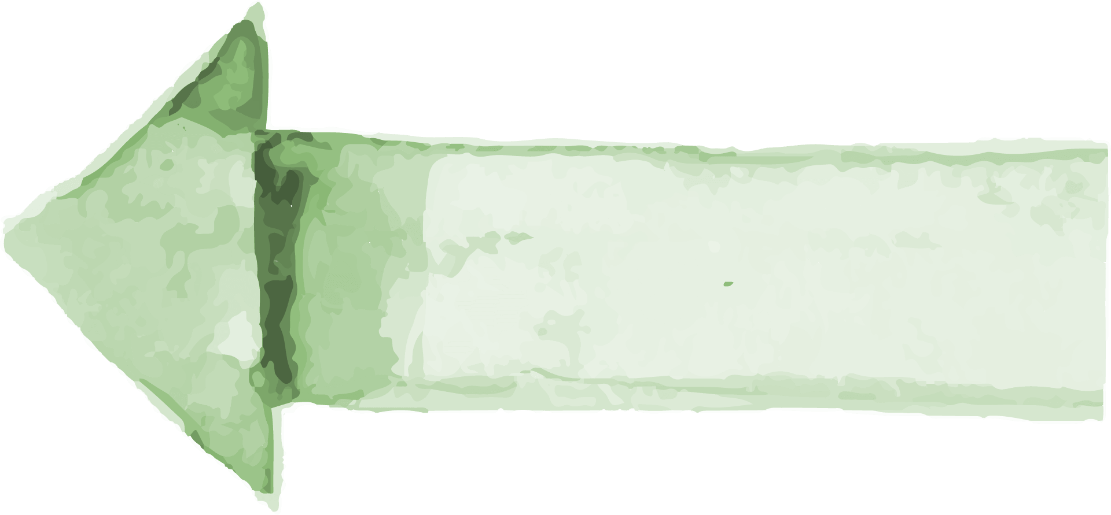


Related Work
CropX
Gaps
Existing Solutions
Hydrawise
Gaps
Provides soil sensors that connect to a mobile app, allowing farmers to monitor soil moisture, temperature, and electrical conductivity in real-time.
Alerts and notifications for system issues.
IA data processing
Smart irrigation control app that connects to their controllers for managing watering schedules.
optimizes water delivery

Slide 10

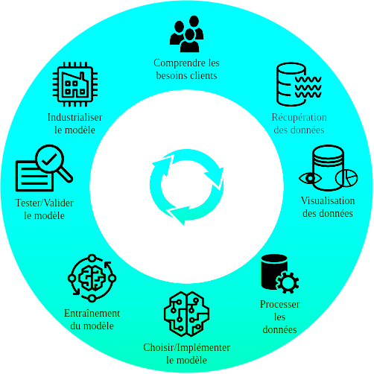
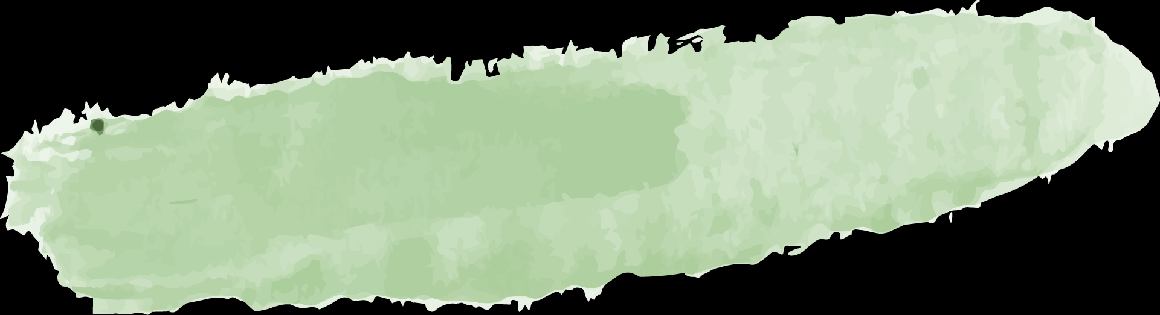
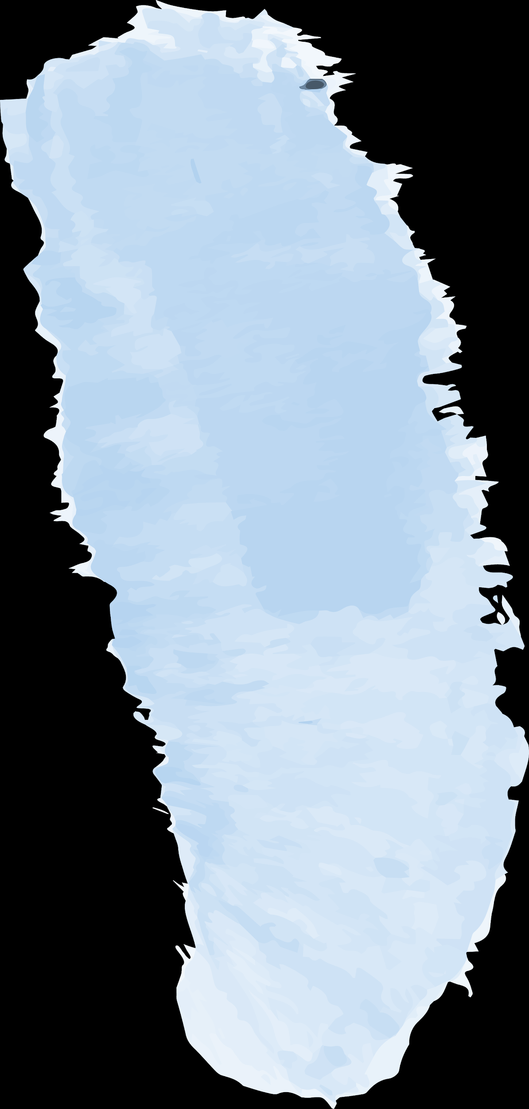
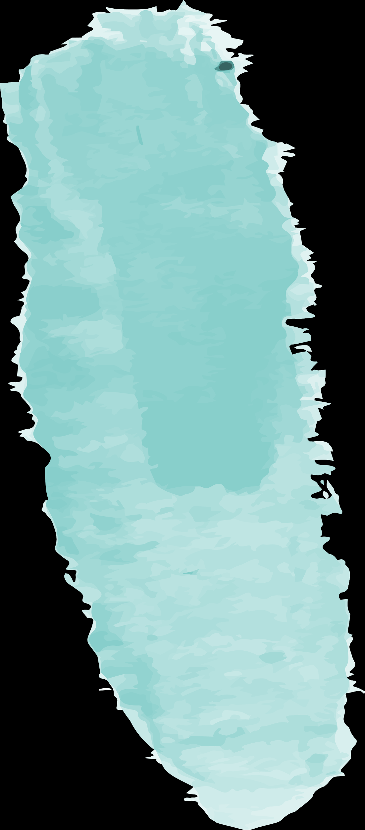

Methodology&Implementation

Slide 11

IOT Based Smart Agriculture
Monitoring of climate conditions: Data collected by smart agriculture sensors, This data is used to track and predict weather conditions.
Crop management: Sensors like soil moisture, temperature, humidity, etc. should be placed in the field to collect data specific to crop farming; from temperature and precipitation to leaf water potential and overall crop health.
Data analytics: The collected data itself will be of little help if you cannot make sense of it. Thus, we used powerful data analytics and apply predictive algorithms and machine learning in order to obtain actionable insights based on the collected data.
The infrastructure: Smart farming applications should be tailored for use in the field. A business owner or farm manager should be able to access the information on site or remotely via a smartphone application.

Slide 12
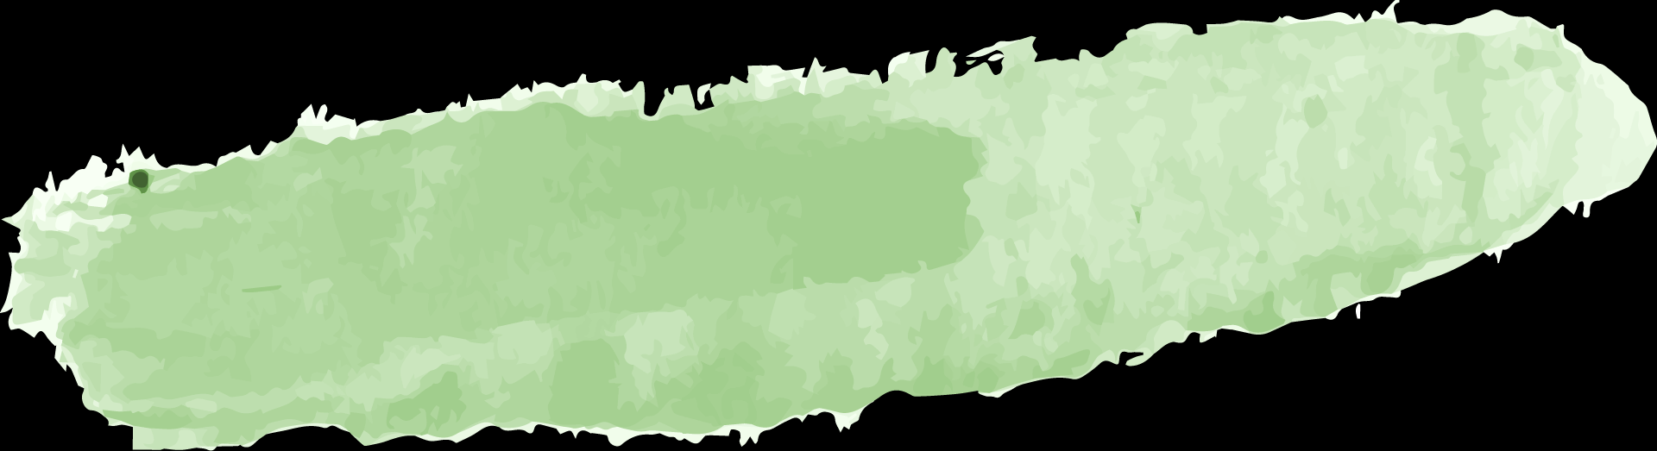
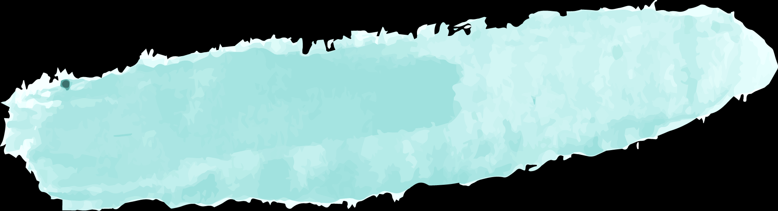

Humidity
Temperature
Central server
Water Level
Soil Moisture
Block Diagram
Si7021:
Accurate humidity measurement, low power consumption
I2C interface, high accuracy, small form factor.
DHT22 (AM2302):
Measures temperature and humidity; digital output; ±0.5°C accuracy for temperature.
Affordable, easy to interface, low power consumption.
Submersible Pressure Transducers:DFROBOT Submersible Pressure Level Sensor
Measures water pressure at a certain depth and calculates the water level; sealed and submersible.
Resistive Soil Moisture Sensor:
Affordable, easy to use.
Less accurate over time.

Slide 13
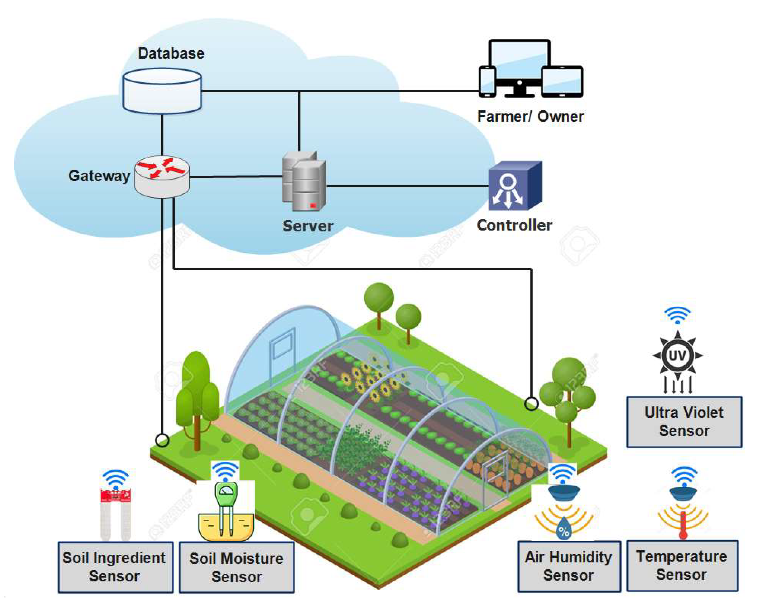



Architecture Overview

Slide 14

Ai and Machine Learning Model
Random Forest Regression:
Why: This algorithm handle non-linear relationships and can model complex interactions between multiple variables like soil moisture, temperature, and humidity. It also work well with small to medium datasets and don’t require a large amount of tuning.
Feature importance: These algorithms will also give insights into which sensor (soil moisture, humidity, or temperature) has the most impact on water consumption.
08

Slide 15
AI Process Work Flow
Data Collection and AI Training
Real-time Monitoring and
Data Collection
Collect historical data onsoilmoisture,temperature,humidity,waterlevel,
Set up a database in the cloud to store and manage the data, Train the AI model using historical data to predict water consumption,
Install soil moisture
sensors humidity,
temperature and water level ,
To continuously collect real-time data.
09

Slide 16
AI Process Work Flow
Reporting and Continuous Improvement
AI Decision -Making
User Interaction
Use AI model to
analyze real-time
data and predict
optimal water consumption.
Create a user-friendly mobile app
for farmers. Enable
monitoring the
Water consumption and detect leakage ,
Develop reporting
mechanisms for
system performance
and sustainability
metrics. Continuously
update the AI model
with new data to
improve accuracy and
efficiency.
10

Slide 17
AI Phases
Training Phase: Model Development and Training
Description: This phase involves collecting environmental data using a sensing network, preprocessing the data, and training a machine learning classifier. The classifier learns to categorize data into groups such as Temperature, Humidity, Water Level, and Soil Moisture based on the training data, laying the groundwork for accurate data classification,
Testing Phase: Model Evaluation
Description:In this phase, the trained classifier evaluates and classifies new, real-time data. It analyzes features of the incoming data and assigns it to predefined categories (Temperature, Humidity, Soil Moisture, Water Level), enabling real-time monitoring and decision-making.
If soil moisture is low and temperature is high, the model may predict increased
water consumption.
humidity is high and soil moisture is adequate, the model might suggest less water is needed.
11

Slide 18
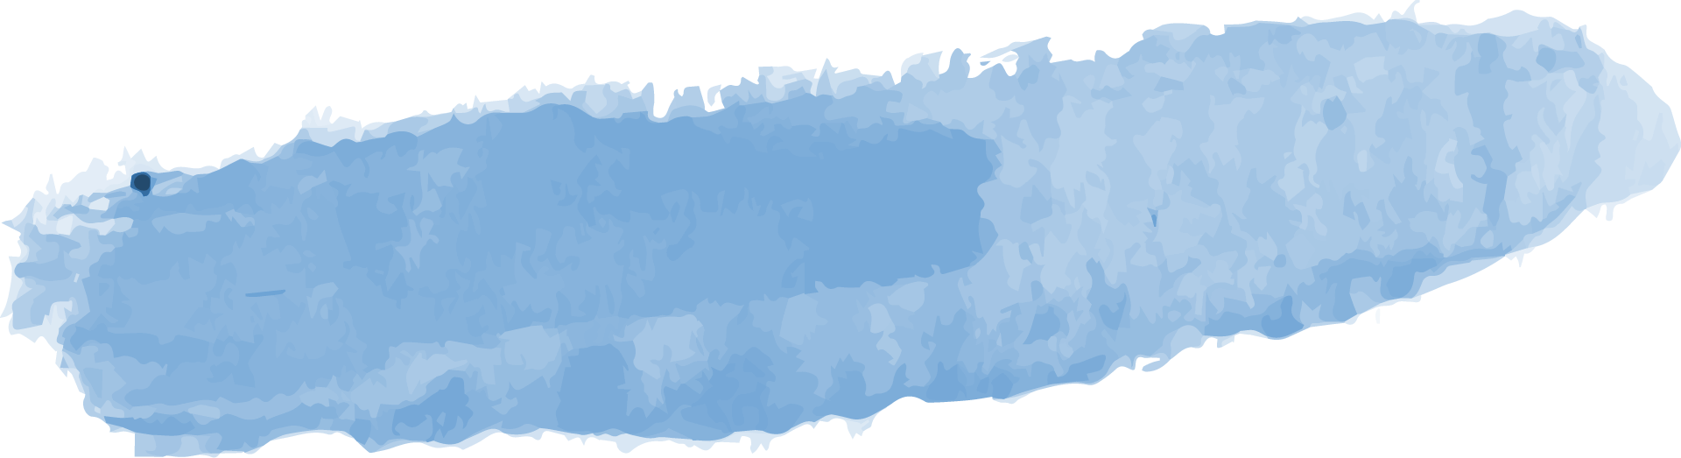
AI and Machine Learning Models
Soil Moisture Prediction
Weather Forecast Integration
Anomaly Detection
Data Visualization
Machine learning models predicting when to irrigate based on real-time and historical data.
Using weather data to adjust irrigation schedules.
Identifying water stress in crops early to prevent damage.
Real-time dashboards showing soil moisture levels, water usage, and alerts.
12

Slide 19

Real-time Monitoring and Decision-Making
Real-time Data Processing
Automated Irrigation Control
Alerts and Notifications
Immediate feedback on soil conditions and water levels.
System triggers irrigation based on AI recommendations
Alerts for extreme conditions, low soil moisture, or predicted drought periods.
13

Slide 20



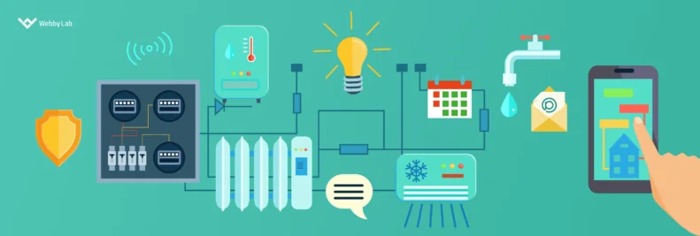

Result

Slide 21



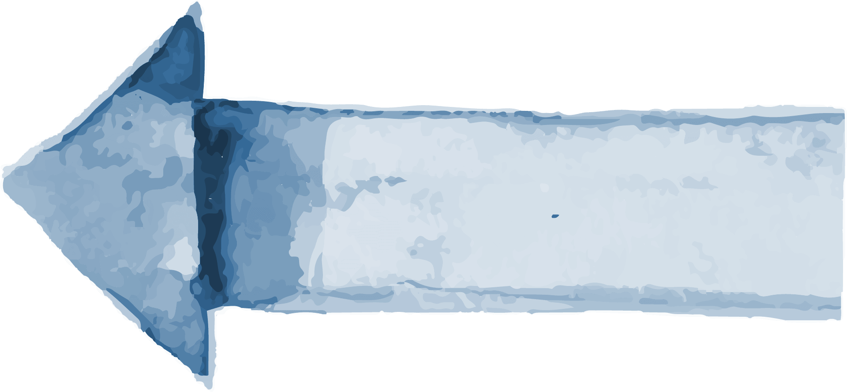
Benefits and Impact
Increased Crop Yields
Sustainability
Water Savings
Promoting eco-friendly farming methods and minimizing the ecological impact.
Expected reduction in water usage by up to 30% through precise irrigation.
Better water management leads to healthier crops and improved yields.
11

Slide 22

Conclusion
AI helps address water scarcity in agriculture by using real-time sensor data to optimize irrigation. By analyzing soil moisture, humidity, and temperature, AI ensures efficient water use, reducing waste, improving crop yields, and promoting sustainable farming amid water shortages.
60%
12

Slide 23
Awesome Words

